Slide 1
CAPSTONE PROJECT
PROJECT REPORT ON:
Plant Disease detection using image processing and machine learning
SUBMITTED BY:
SUBMITTED TO:
17BEI0077 - SHREY GUPTA
17BEE0358- RAHUL GUPTA
17BEE0288 – ISHAN GOEL
Dr. RAJINI GK
Associate Professor
School of Electrical Engineering

Slide 2
Abstract:
This enables machine vision that is to provide image-based automatic inspection, process control. Comparatively, visual identification is labour intensive less accurate and can be done only in small areas. The project involves the use of self-designed image processing algorithms and techniques designed using python to segment the disease from the leaf while using the concepts of machine learning to categorise the plant leaves as healthy or infected. By this method, the plant diseases can be identified at the initial stage itself and the pest and infection control tools can be used to solve pest problems while minimizing risks to people and the environment.

Slide 3
Objective
To do the performance analysis of the implemented classifier(classical ML models) on given set of extracted features fed as a training data to the model and pre-processing performed with a given segmentation technique .
To achieve better accuracy in terms of classifying plant as a diseased or not.

Slide 4
Methodology
The step-by-step procedure of the proposed system:
Pre-processing the image
Segment the components;
Obtain useful segments;
Evaluating feature parameters for classification;
Training the models.
Retrieving the result

Slide 5
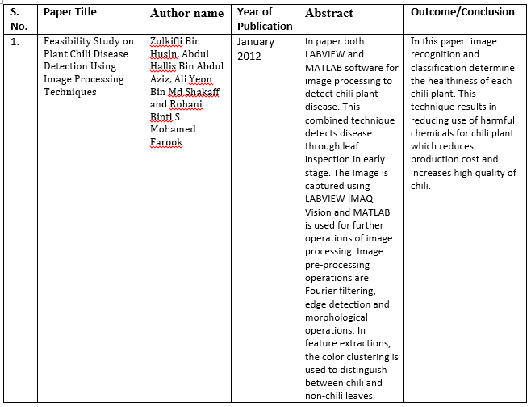
Literature Review

Slide 6
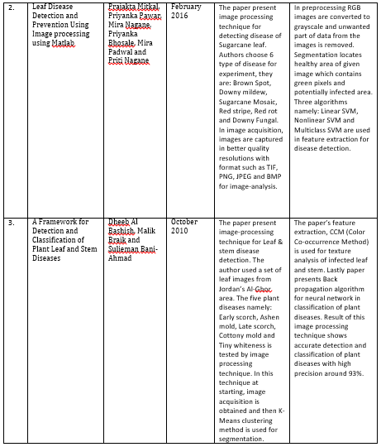

Slide 7
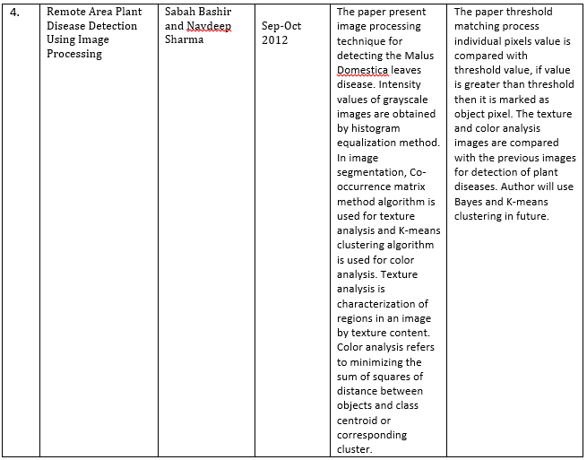
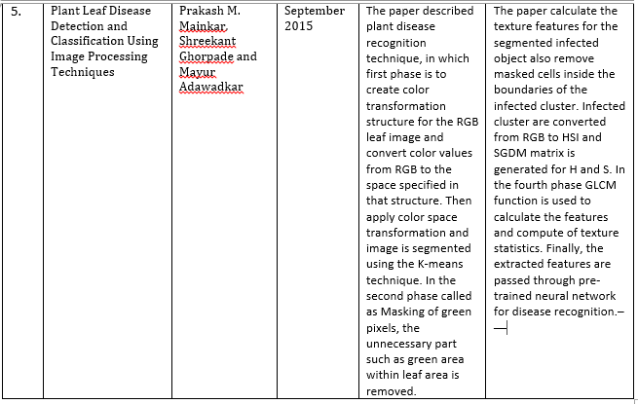

Slide 8
SEGMENTATION CODE:
Segmentation using masking Technique
def img_segmentation(img):
rgb_img=cv2.cvtColor(img,cv2.COLOR_BGR2RGB)
lab_img=cv2.cvtColor(rgb_img,cv2.COLOR_RGB2LAB)
g_m=cv2.inRange(lab_img,np.array([0,130,0]),np.array([250,255,255]))
g_m=~g_m
d_m=cv2.inRange(lab_img,np.array([0,130,135]),np.array([255,255,235]))
d_m=d_m
f_m=d_m+g_m
seg_img=cv2.bitwise_and(rgb_img,rgb_img,mask=f_m)
return seg_img

Slide 9
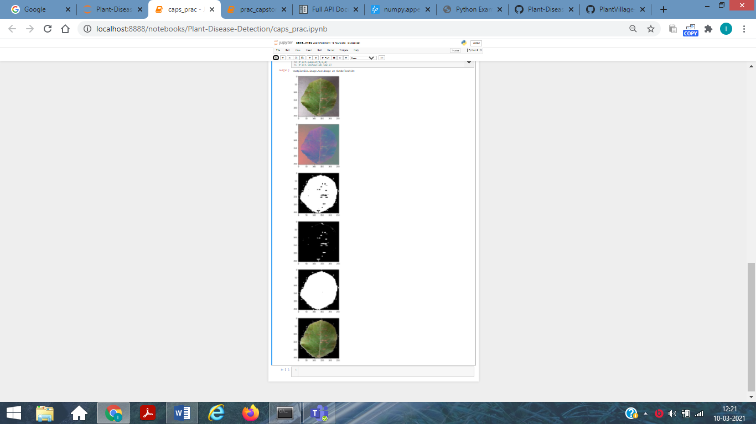
Result of segmentation

Slide 10
Segmentation using SLIC(Simple Linear iterative clustering)
from skimage import segmentation
import numpy as np
import cv2
from skimage import morphology
from matplotlib import pyplot as plt
from skimage.segmentation import mark_boundaries
image = cv2.cvtColor(img, cv2.COLOR_BGR2LAB)
segments = segmentation.slic(image, compactness=1, n_segments=3)
region2=segments==2
region0=segments==0
region1=segments==1
region3=segments==3

Slide 11
for i in range(0,256):
for j in range (0,256):
if region0[i][j]==True:
image[i][j][0]=0
image[i][j][1]=0
image[i][j][2]=0
for i in range(0,256):
for j in range (0,256):
if region1[i][j]==True:
image[i][j][0]=0
image[i][j][1]=0
image[i][j][2]=0
seg_img=image
seg_img=cv2.cvtColor(seg_img, cv2.COLOR_LAB2RGB)
for i in range(0,256):
for j in range (0,256):
if seg_img[i][j][0]==0 and seg_img[i][j][1]==64 and seg_img[i][j][2]==194:
seg_img[i][j][0]=0
seg_img[i][j][1]=0
seg_img[i][j][2]=0

Slide 12
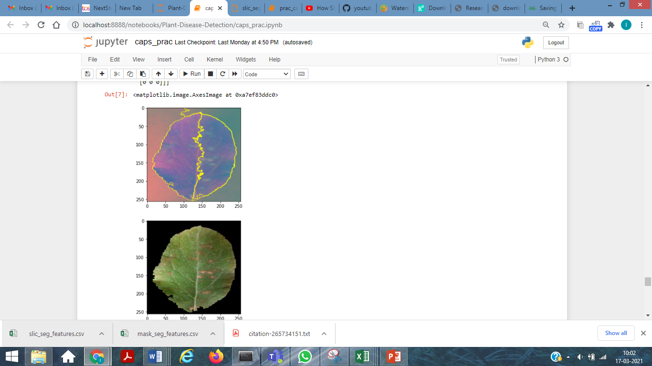
Output

Slide 13

SLIC ALGO (simple linear iterative clustering)
Distance measure
m-> measure(proximity consider for a superpixel)
Eq-1
Gradient measure
where I(x, y) is the lab vector corresponding to the pixel at position (x, y), and k.k is the L2 norm

Slide 14
Algorithm
1) Initialize cluster centers Ck = [lk, ak, bk, xk, yk]^T by sampling pixels at regular grid steps S.
2: Shift cluster centers in an n × n neighborhood, to the lowest gradient position.
3: repeat
4: for each cluster center Ck do
5) Assign the best matching pixels from a 2S × 2S square neighborhood around the cluster center according to the distance measure (Eq. 1).
6: end for
7: Compute new cluster centers and residual error E {L1 distance between previous centers and recomputed centers}
8: until E ≤ threshold
9: Enforce connectivity

Slide 15
Parameters/Features extracted
1) Hu moments
Code:
def fd_hu_moments(image):
image = cv2.cvtColor(image, cv2.COLOR_BGR2GRAY)
feature = cv2.HuMoments(cv2.moments(image)).flatten()
return feature
2) Haralick features
Code:
def fd_haralick(image):
gray = cv2.cvtColor(image, cv2.COLOR_BGR2GRAY)
haralick = mahotas.features.haralick(gray).mean(axis=0)
return haralick

Slide 16
3) Color histogram
def fd_histogram(image, mask=None):
image = cv2.cvtColor(image, cv2.COLOR_BGR2HSV)
hist = cv2.calcHist([image], [0, 1, 2], None, [bins, bins, bins], [0, 256, 0, 256, 0, 256])
cv2.normalize(hist, hist)
return hist.flatten()
4) Color features
Code:
def fd_color(image):
import mahotas
import cv2
import numpy as np
from skimage.feature.texture import greycomatrix
# test_img=cv2.imread(image)
test_hsv=cv2.cvtColor(image,cv2.COLOR_BGR2HSV)
h_mean,h_std=cv2.meanStdDev(h)
s_mean,s_std=cv2.meanStdDev(s)
color_fea=np.array([h_mean,h_std,s_mean,s_std])
haralick_fea = mahotas.features.haralick(v).mean(axis=0)
color_fea=np.append(color_fea,haralick_fea)
return color_fea

Slide 17
Extracting Features and organizing it for training data
Code:
ptr=1
# data=pd.dataframe()
for training_name in train_labels:
# join the training data path and each species training folder
dir = os.path.join(train_path, training_name)
current_label = training_name
if(ptr==1):
images_per_class=805
else:
images_per_class=904
for x in range(1,images_per_class+1):
file = dir + "/" + str(x) + ".jpg"
image = cv2.imread(file)
image = cv2.resize(image, fixed_size)

Slide 18
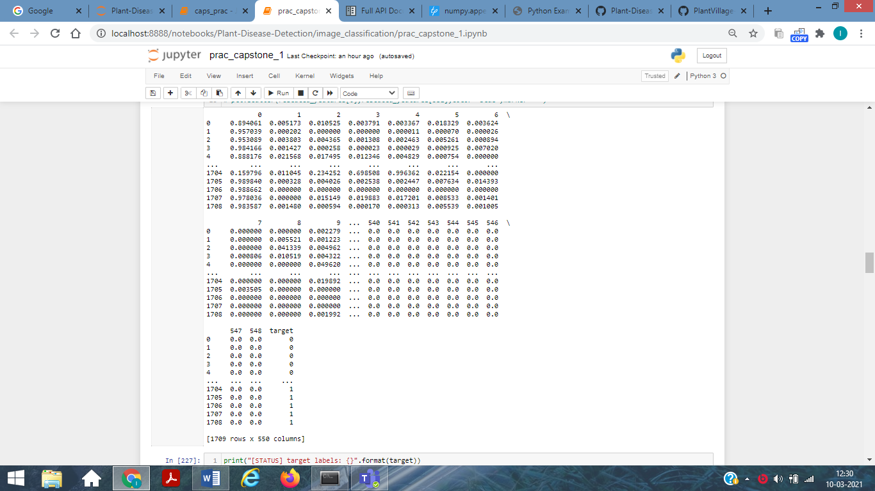

Slide 19
IMG_SEGMENT = img_segmentation(image)
fv_hu_moments = fd_hu_moments(IMG_SEGMENT)
fv_haralick = fd_haralick(IMG_SEGMENT)
fv_histogram = fd_histogram(IMG_SEGMENT)
fv_color_fea= fd_color(IMG_SEGMENT)
global_feature = np.hstack([fv_histogram, fv_haralick, fv_hu_moments,fv_color_fea])
labels.append(current_label)
global_features.append(global_feature)
print("[STATUS] processed folder: {}".format(current_label))
ptr+=1
print(fv_color_fea)
print(len(fv_histogram) )
print("[STATUS] completed Global Feature Extraction...")
import pandas as pd
import numpy as np
from matplotlib import pyplot as plt
from sklearn.preprocessing import MinMaxScaler
scaler= MinMaxScaler(feature_range=(0, 1))
rescaled_features=scaler.fit_transform(global_features)
# data=pd.DataFrame(rescaled_features,columns=[np.arange(0,532,1)])
data=pd.DataFrame(rescaled_features)
# target=labels;
data["target"]=target
print(data)

Slide 20
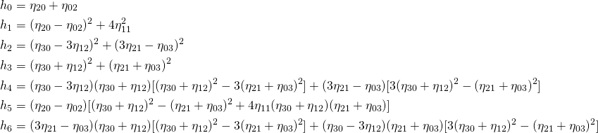



Hu Moments (or rather Hu moment invariants ) are a set of 7 numbers calculated using central moments that are invariant to image transformations. The first 6 moments have been proved to be invariant to translation, scale, and rotation, and reflection. While the 7th moment’s sign changes for image reflection.
This feature vector can be used to quantify and represent the shape of an object in an image
Raw Moments
Centroid using Image Moments
The centroid of a binary blob is simply its center of mass. The centroid is calculated using the following formula.
Central moments are very similar to the raw image moments we saw earlier, except that we subtract off the centroid from the
and
in the moment formula.

Slide 21
Texture Features
Texture features description of spatial arrangement of colour or intensity in an image or selected areas.
These feature are majorly of 2 types:
1) First order features: These features are statistically calculated from original image values of single pixels i.e they do not consider any relationship with neighbours. Eg: Variance, Standard Deviation, Mean ,Entropy etc.
2) Second Order Features: this measure consider the relationship between 2 pixels. Calculated using GLCM Matrix.

Slide 22
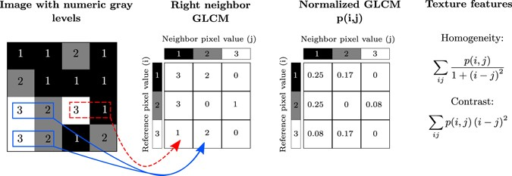
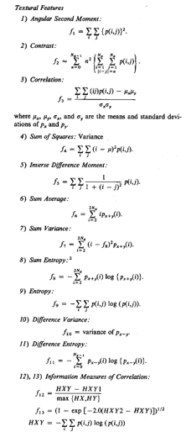
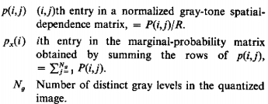
Haralick features
Haralick texture features are calculated from a Gray Level Co-occurrence Matrix, (GLCM), a matrix that counts the co-occurrence of neighboring gray levels in the image. The GLCM is a square matrix that has the dimension of the number of gray levels N in the region of interest (ROI). Figure 4 gives an overview of how the GLCM is constructed and how the texture features are calculated.

Slide 23
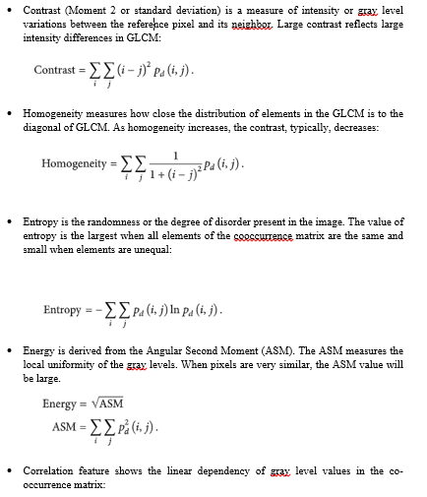
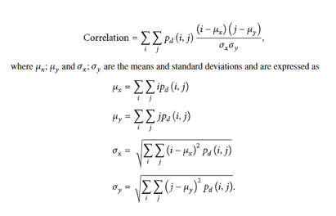

Slide 24
Algorithms for classification
1. Logistics Regression:
2. K Nearest Neighbors:
3. Support Vector Machine Algorithm:
4. Naïve Bayes Classifier Algorithm
5. Decision Tree Classification Algorithm:
6. Random Forest:

Slide 25
Work Plan
REV1- Title Finalization And Rough work plan of our work
REV2-Segmentation and Features Extraction
REV3-Implementing The Classifier and getting accuracy results with slic and masking technique
REV4-Documentation

Slide 26
Source of Dataset
https://github.com/spMohanty/PlantVillage-Dataset/tree/master/raw/color

Slide 27
Reference
https://towardsdatascience.com/
Ko Ko Zaw, Zin Ma Ma Myo, and Wah Wah Hlaing. 2018. “Multiclass Support Vector Machine Based Detection and Classification of Leaf Diseases”, 11th National Conference on Science and Engineering, YTU, Yangon,
S. S. Panchal, R. Sonar. 2016. “Pomegranate Leaf Disease Detection Using Support Vector Machine,” International Journal of Engineering and Computer Science, vol. 5, no 6, pp. 16815-16818.
D. Gadkari. 2004. “Image Quality Analysis Using GLCM,” M.E. thesis, University of Central Florida, Orlando, Florida.
Cong, Jinyu & Wei, Benzheng & Yin, Yilong & Xi, Xiaoming & Zheng, Yuanjie. (2014). Performance evaluation of simple linear iterative clustering algorithm on medical image processing. Bio-medical materials and engineering. 24. 3231-8. 10.3233/BME-141145.
http://haralick.org/journals/TexturalFeatures.pdf
https://en.wikipedia.org/wiki/Image_moment

Slide 28
Prakash M. Mainkar, Shreekant Ghorpade and Mayur Adawadkar “Plant Leaf Disease Detection and Classification Using Image Processing Techniques” International Journal of Innovative and Emerging Research in Engineering Volume 2, Issue 4, 2015, e-ISSN: 2394 – 3343, p-ISSN: 2394 – 5494.
Sabah Bashir and Navdeep Sharma “Remote Area Plant Disease Detection Using Image Processing” IOSR Journal of Electronics and Communication Engineering (IOSRJECE) ISSN : 2278-2834 Volume 2, Issue 6 (Sep-Oct 2012), PP 31-34.
Dheeb Al Bashish, Malik Braik and Sulieman Bani-Ahmad “A Framework for Detection and Classification of Plant Leaf and Stem Diseases” 2010 IEEE International Conference on Signal and Image Processing, pp. 978-1-4244-8594-9/10.
Zulkifli Bin Husin, Abdul Hallis Bin Abdul Aziz, Ali Yeon Bin Md Shakaff and Rohani Binti S Mohamed Farook “Feasibility Study on Plant Chili Disease Detection Using Image Processing Techniques” 2012 IEEE Third International Conference on Intelligent Systems Modelling and Simulation, pp. 978-0-7695-4668-1/12.
Sachin D. Khirade, A. B. Patil, “Plant Disease Detection Using Image Processing” 2015 IEEE International Conference on Computing Communication Control and Automation, pp. 978-1-4799-6892-3/15.

Slide 29


